Slide 1


Machine Learning Based
Crop Recommendation
Using KNN | Decision Tree | Random Forest
D. Madhu Sudhan Reddy, Assistant Professor, CSBS, BVRIT
D. Jagadeesh, Assistant Professor, CSE, BVRIT
P. Bhaskar Rao, Assistant Professor, CSE, BVRIT
Notes:
Introduce yourself and the project. This work was presented at NASSCOM and demonstrates how ML can empower farmers to make data-driven crop decisions.

Slide 2
The Problem & Motivation
Farmer's Challenge: A farmer wants to seed a crop on his/her farmland. The very first step is to decide which crop is the best fit for the soil conditions — a decision that has traditionally relied on experience and guesswork.
🌡
🌧
📉
Variable Soil Conditions
Climate Variability
Yield & Financial Risk
N, P, K levels, pH, and moisture differ farm-to-farm and season-to-season.
Temperature, humidity and rainfall patterns are increasingly unpredictable.
Wrong crop choice leads to crop failure, debt, and food insecurity for families.
Notes:
Explain the farmer's dilemma. Crop selection is critical and depends on multiple soil and weather factors. Machine learning offers a data-driven solution.

Slide 3
Project Workflow
01
Import Libraries
06
Decision Tree Model
Python tools: pandas, sklearn, seaborn, matplotlib
Gini criterion, depth-unlimited — 98.91% accuracy
02
Dataset Overview
07
Random Forest Model
2,200 records, 7 features, 22 crop classes
100 estimators, ensemble — 99.64% accuracy
03
Exploratory Data Analysis
08
Model Comparison
Statistics, data types, missing values, unique crops
Accuracy, Precision, Recall across all three models
04
Data Preparation
09
Summary & Conclusion
Feature/target split, 75/25 train-test split
RF is best; future scope and deployment ideas
05
KNN Model
K=5, Minkowski metric — 97.82% accuracy
Notes:
Walk through the agenda quickly. The presentation follows the exact structure of the notebook.

Slide 4
Section 1: Import Libraries
📊
pandas
📈
matplotlib
Data loading, manipulation and DataFrame operations on the CSV dataset.
Generating plots like confusion matrix heatmaps and decision tree visualizations.
🎨
seaborn
🤖
sklearn
High-level statistical plots — bar charts and heatmaps for model comparison.
Core ML library — KNN, DT, RF classifiers, train-test split, metrics.
Notes:
These are the four key Python libraries used. Sklearn is the heart of the ML pipeline.

Slide 5
Section 2: Dataset Overview
2,200
7
22
0
Total Records
Input Features
Crop Classes
Missing Values
Input Features (X)
22 Target Crop Classes (y)
Feature | Description | Unit
N | Nitrogen ratio in soil | mg/kg
P | Phosphorous content | mg/kg
K | Potassium content | mg/kg
temperature | Soil / air temperature | °C
humidity | Relative humidity | %
ph | Soil pH value | 0-14
rainfall | Annual rainfall | mm
🌿 Rice, Maize, Chickpea, Kidneybeans
🌿 Pigeonpeas, Mothbeans, Mungbean
🌿 Blackgram, Lentil, Pomegranate
🌿 Banana, Mango, Grapes, Watermelon
🌿 Muskmelon, Apple, Orange, Papaya
🌿 Coconut, Cotton, Jute, Coffee
Notes:
The dataset has 2200 rows and 8 columns. 7 features describe the soil and climate conditions. The label column has 22 unique crops. There are no missing values — clean dataset ready for ML.

Slide 6
Section 3: Exploratory Data Analysis
Descriptive Statistics (df.describe)
Key EDA Findings
Feature | Mean | Std | Min | Max
N (Nitrogen) | 50.6 | 36.9 | 0 | 140
P (Phosphorus) | 53.4 | 33.0 | 5 | 145
K (Potassium) | 48.1 | 50.6 | 5 | 205
Temperature | 25.6°C | 5.1 | 8.8 | 43.7
Humidity | 71.5% | 22.3 | 14.3 | 99.9
pH | 6.5 | 0.77 | 3.5 | 9.9
Rainfall | 103.5mm | 55.0 | 20.2 | 298.6
✅
No missing values
All 2200 rows are complete — no imputation needed.
📐
Numeric features
N, P, K are int64; temperature, humidity, pH, rainfall are float64.
🌾
22 balanced classes
Each crop has exactly 100 samples (2200 ÷ 22).
⚖️
Balanced dataset
No class imbalance — fair evaluation for all models.
🌡
Wide pH range
pH ranges from 3.5 (acidic) to 9.9 (alkaline).
Notes:
The dataset is clean and balanced. Each of the 22 crops has exactly 100 samples, which means our accuracy scores reflect real performance without class imbalance bias.

Slide 7
Section 4: Data Preparation
Step 1: Feature & Target Split
X (Features)
y (Target)
dataset.iloc[ : , :-1 ]
dataset.iloc[ : , -1 ].values
All 7 columns except label
N, P, K, temperature,
humidity, pH, rainfall
Last column only
22 crop class labels
(string array)
Step 2: Train / Test Split (test_size = 0.25)
Training samples:
1,650
Testing samples:
550
Random state:
0 (reproducible)
Notes:
The dataset is split into X (features) and y (target). Then 75% goes to training and 25% to testing with a fixed random_state=0 for reproducibility.

Slide 8
K-Nearest Neighbors — Core Concepts
What is KNN?
How It Works
Pros & Cons
KNN is a non-parametric, lazy learning algorithm. It makes no assumptions about the data distribution and stores all training instances.
Key idea:
"Similar inputs produce similar outputs." A new point is classified by majority vote of its K closest neighbours.
1
Store all training data in memory
Advantages
+ No training phase needed
+ Multi-class by default
2
Compute distance to every training point
+ No parametric assumptions
Limitations
3
Sort and pick the K=5 nearest neighbours
- Slow prediction O(n)
Type: Supervised, Instance-based
- Sensitive to feature scale
Task: Classification & Regression
Distance: Euclidean (Minkowski p=2)
- High memory usage
4
Majority vote determines the predicted class
Training: None (lazy learner)
d = sqrt( sum( (xi - yi)^2 ) )
K=5: odd value avoids ties; balances bias-variance tradeoff.
Notes:
KNN concept slide: explain lazy learning, distance metric, and the role of K. This sets context before showing the actual results.

Slide 9
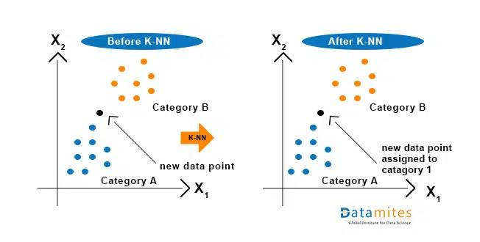
Section 5: K-Nearest Neighbors (KNN)
Notes:
KNN with K=5 and Euclidean distance achieves 97.82% accuracy. The model is simple and intuitive but slightly slower at prediction time as it compares against all training points.

Slide 10
Section 5: K-Nearest Neighbors (KNN)
How KNN Works
KNN Results
1 Given soil parameters, find K=5 nearest training samples using distance.
97.82%
Precision: 0.98
Recall: 0.98
F1-Score: 0.98
2 Count the majority crop label among those 5 neighbours.
Accuracy
Accuracy
97.8%
3 Predict that crop for the new soil data point.
Precision
98.0%
4 Distance metric: Minkowski (p=2 = Euclidean distance)
Recall
98.0%
📋 Confusion Matrix Insight
classifier = KNeighborsClassifier(
n_neighbors=
5, metric='minkowski', p=2)
Most off-diagonal entries are zero. A few crop pairs (e.g., mothbeans/mungbean) show 1–2 misclassifications due to similar NPK profiles.
Notes:
KNN with K=5 and Euclidean distance achieves 97.82% accuracy. The model is simple and intuitive but slightly slower at prediction time as it compares against all training points.

Slide 11
Decision Tree — Core Concepts
What is a Decision Tree?
Key Concepts
Pros & Cons
A Decision Tree is a flowchart-like structure that splits data into subsets based on feature values, creating a tree of decisions that leads to a predicted class.
Each node tests one feature; each branch represents an outcome; each leaf holds a class label.
Root Node
Advantages
The topmost split — uses the most discriminating feature (highest information gain).
+ Highly interpretable
+ Handles non-linear boundaries
Internal Node
+ No feature scaling needed
Tests a feature condition (e.g., rainfall > 200mm).
Limitations
Leaf Node
- Prone to overfitting
Terminal node; holds the final predicted class label.
- High variance (unstable)
Type: Supervised, Non-Parametric
Criterion: Gini Impurity
- Biased with imbalanced data
Max Depth: Unlimited (default)
Gini Impurity
Measures disorder: Gini = 1 - sum(pᵢ²). Lower Gini = purer node.
Overfit fix: set max_depth, min_samples_split, or use pruning.
Notes:
Decision Tree concept: explain how nodes split data using Gini impurity. Highlight that full depth trees can overfit — Random Forest solves this via ensembling.

Slide 12
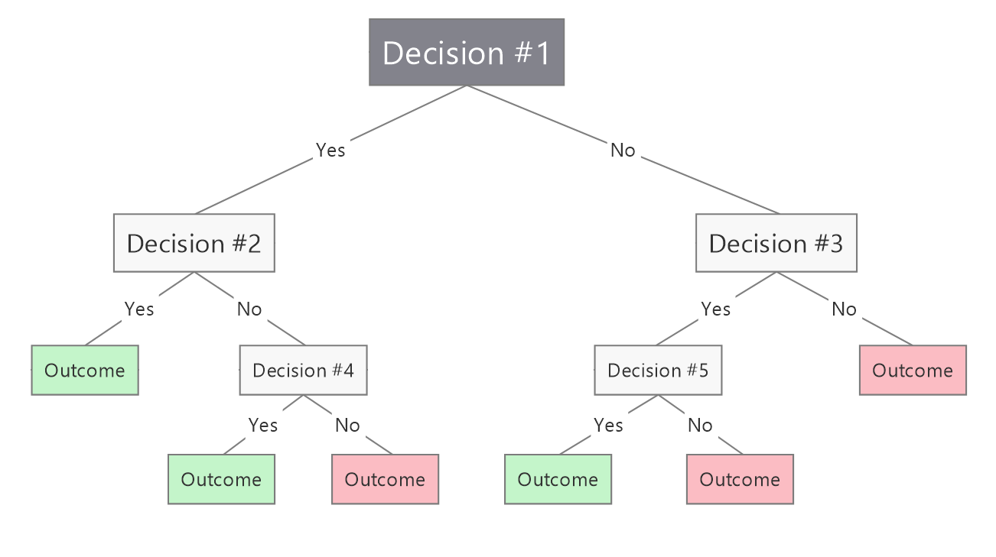
Section 6: Decision Tree (DT)
Decision Tree Results
Notes:
The Decision Tree improves to 98.91%. The tree is fully grown (no max_depth limit), which achieves higher accuracy but may slightly overfit compared to a pruned tree.

Slide 13
Section 6: Decision Tree (DT)
How Decision Tree Works
Decision Tree Results
1 Starts at the root: selects the best feature to split by (using Gini impurity).
98.91%
Precision: 0.99
Recall: 0.99
F1-Score: 0.99
2 Recursively creates branches — each split narrows down crop possibilities.
Accuracy
Accuracy
98.9%
3 At leaf nodes, assigns the majority crop label for that branch.
Precision
99.0%
4 Unlimited depth allowed (random_state=0 for reproducibility).
Recall
99.0%
🌳 Tree Visualization
clf = DecisionTreeClassifier(
random_state=
0)
clf.fit(X_train, y_train)
Decision tree was visualized using sklearn's plot_tree (40×15 inches). The tree shows feature splits at each node — key splits use rainfall and temperature.
Notes:
The Decision Tree improves to 98.91%. The tree is fully grown (no max_depth limit), which achieves higher accuracy but may slightly overfit compared to a pruned tree.

Slide 14
Random Forest — Core Concepts
What is Random Forest?
Two Key Techniques
Pros & Cons
Random Forest is an ensemble learning method that builds many Decision Trees on random subsets of data and features, then combines their predictions via majority voting.
It reduces overfitting and variance by averaging out errors across all trees.
Bagging (Bootstrap Aggregating)
Advantages
Each tree trains on a random sample drawn WITH replacement from the training data. Reduces variance without increasing bias.
+ Robust to overfitting
+ Handles noisy data well
+ Built-in feature importance
Limitations
Feature Randomness
- Slower than single tree
At each split, only a random subset of sqrt(n_features) features is considered. Creates diverse, decorrelated trees — the key to the ensemble advantage.
Type: Supervised, Ensemble
- Less interpretable (black box)
n_estimators: 100 trees (default)
- Higher memory usage
Sampling: Bootstrap (with replacement)
Final Prediction: majority vote across all 100 trees eliminates individual tree errors.
Notes:
Random Forest concept: the two key innovations are Bagging (row sampling) and Feature Randomness (column sampling). Together these create diverse, low-correlation trees whose errors cancel out in the majority vote.

Slide 15
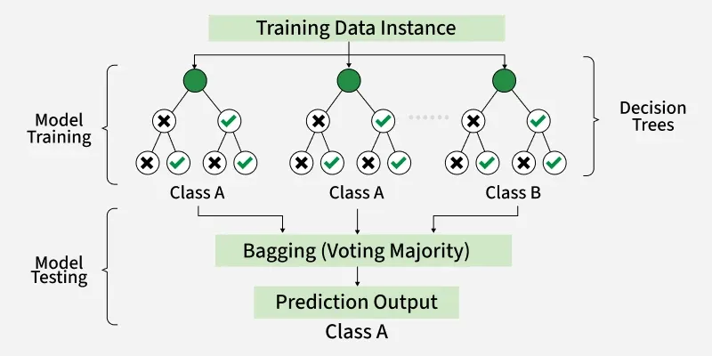
Section 7: Random Forest (RF)
Notes:
Random Forest achieves the best accuracy of 99.64%, with precision and recall of 1.00 (macro avg). Rainfall is the most important feature. The ensemble nature eliminates most errors from a single tree.

Slide 16
Section 7: Random Forest (RF)
How Random Forest Works?
Random Forest Results
1 Builds 100 decision trees on random subsets of training data (bootstrap sampling).
99.64%
Precision: 1.00
Recall: 1.00
F1-Score: 1.00
2 Each tree considers a random subset of features at each split.
Accuracy
Accuracy
99.6%
3 Final prediction = majority vote among all 100 trees (ensemble).
Precision
100.0%
4 Reduces overfitting compared to a single Decision Tree.
Recall
100.0%
🔑 Feature Importance (Top 3)
rfc = RandomForestClassifier()
rfc.fit(X_train, y_train)
y_pred
= rfc.predict(X_test)
1. Rainfall — highest discriminative power
2. Humidity — separates tropical from dry crops
3. Temperature — key for fruit vs grain crops
Notes:
Random Forest achieves the best accuracy of 99.64%, with precision and recall of 1.00 (macro avg). Rainfall is the most important feature. The ensemble nature eliminates most errors from a single tree.

Slide 17

Section 8: Model Comparison
Model | Accuracy | Precision | Recall | F1-Score
KNN | 97.82% | 0.98 | 0.98 | 0.98
Decision Tree | 98.91% | 0.99 | 0.99 | 0.99
Random Forest ★ | 99.64% | 1.00 | 1.00 | 1.00
Winner: Random Forest
99.64% accuracy
Perfect precision & recall (1.00)
Best generalization from ensemble
Accuracy Improvement
KNN → DT: +1.09% | DT → RF: +0.73% | KNN → RF: +1.82%
Notes:
All three models perform exceptionally well on this dataset. Random Forest is the best at 99.64%. Note that the y-axis starts at 96% to better visualize the differences.

Slide 18
Feature Importance Analysis (Random Forest)
What This Means
Rainfall (28%)
Differentiates water-hungry crops (rice, banana) from drought-tolerant ones (cotton, maize).
Humidity (24%)
Separates tropical crops from those suited to dry climates.
Temperature (22%)
Critical for fruits (apple: cold) vs tropical crops (coconut, mango: warm).
pH (12%)
Distinguishes acid-loving crops (coffee, blueberry) from alkaline-tolerant ones.
NPK (14%)
Soil nutrients matter less than climate — they can be corrected with fertilizers.
Notes:
The feature importance plot from Random Forest shows that climate features (rainfall, humidity, temperature) dominate over soil chemistry features. This is important insight for agricultural extension workers.

Slide 19
Section 9: Summary & Conclusions
Clean & Balanced Dataset
Random Forest is the Best
01
2200 records, 22 crops, 7 features, zero missing values — ideal for ML benchmarking.
03
Ensemble method reduces variance. Macro-avg precision & recall = 1.00 — near-perfect.
All Models Perform Strongly
Climate Drives Crop Choice
02
KNN (97.82%), DT (98.91%), RF (99.64%) — all far above random baseline of 4.5%.
04
Rainfall, humidity & temperature together account for 74% of the feature importance.
Future Scope
→ Deploy as mobile app for farmers
→ Extend to Telangana-specific crop varieties
→ Integrate real-time soil sensor data
→ Combine with weather API for live recommendations
→ Add SVM, XGBoost, Neural Network comparison
Notes:
Summarise the project: all 3 models work well, RF is the best. Climate features are most predictive. Future work can extend this to real-time IoT-based systems.

Slide 20
Thank You!
Notes:
Close with your contact details and invite questions. Emphasize practical applications for Indian agriculture.

